Slide 1
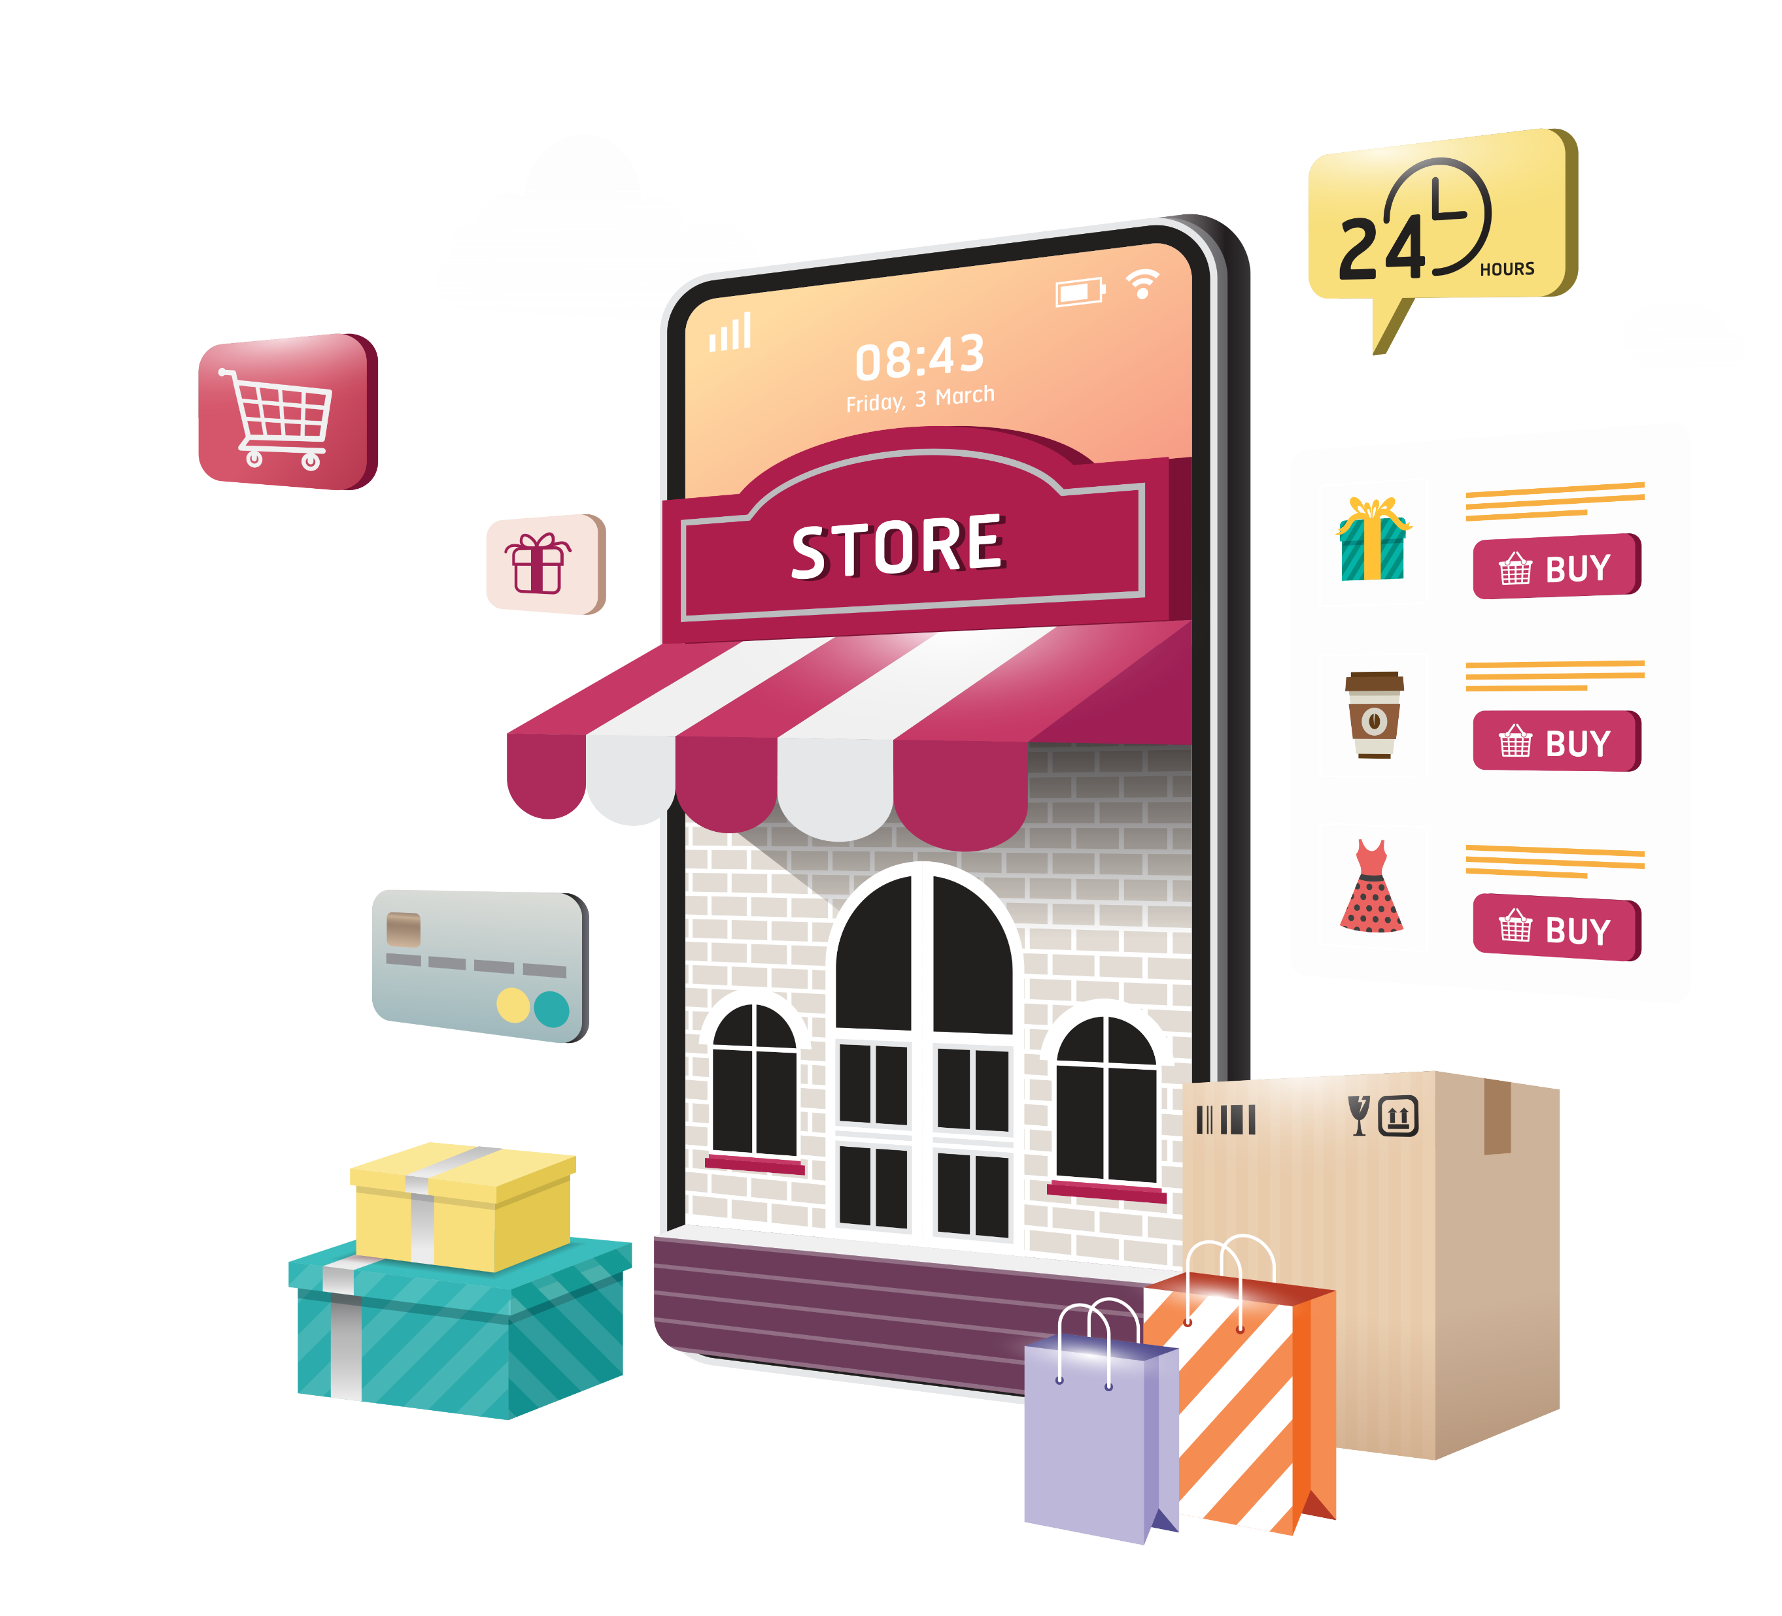
Objective
Anand Store wants to create an annual sales report for 2022 .So that, Anand can understand their customer and grow more sales in 2023.

Slide 2

Sample questions
Compare the sales and orders using single chart.
Who purchased more- men or women in 2022?
Which month got the highest sales and orders?
List Top 10 or 5 states contributing to the sales?
What are the different order status in2022?
Relation between age and gender based on number of orders.
Which channel is contributing to maximum sales?
Highest selling category?...etc.

Slide 3

SAMPLE INSIGHTS
Women are more likely to buy compared to men (~65%)
Adult age group(30-49 years) is max contributing (~50%)
Maharashtra, Karnataka and Uttar Pradesh are the top 3 states (~35%)
Amazon, Flipkart and Myntra channel are max contributing (~80%)

Slide 4
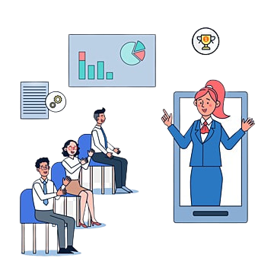

Final Conclusion to improve Anand store sales:
Target Women customers of age group(30-49 years) living in Maharashtra, Karnataka and Uttar Pradesh by showing ads/offers/coupons available on Amazon, Flipkart and Myntra.

